Slide 1
Bird species identification from an image
Manideep Chenna(042)
Jagadeesh reddie(039)
Batch no:122

Slide 2
Table of Contents
Problem Statement
Flow Chart
Flask
Results

Slide 3
Problem Statement
The project aims to quantify the description of different bird species using machine learning techniques and use it as a useful tool for bird species identification from images.
This project attempts to design and adopt the bird species identification system based on the image.

Slide 4
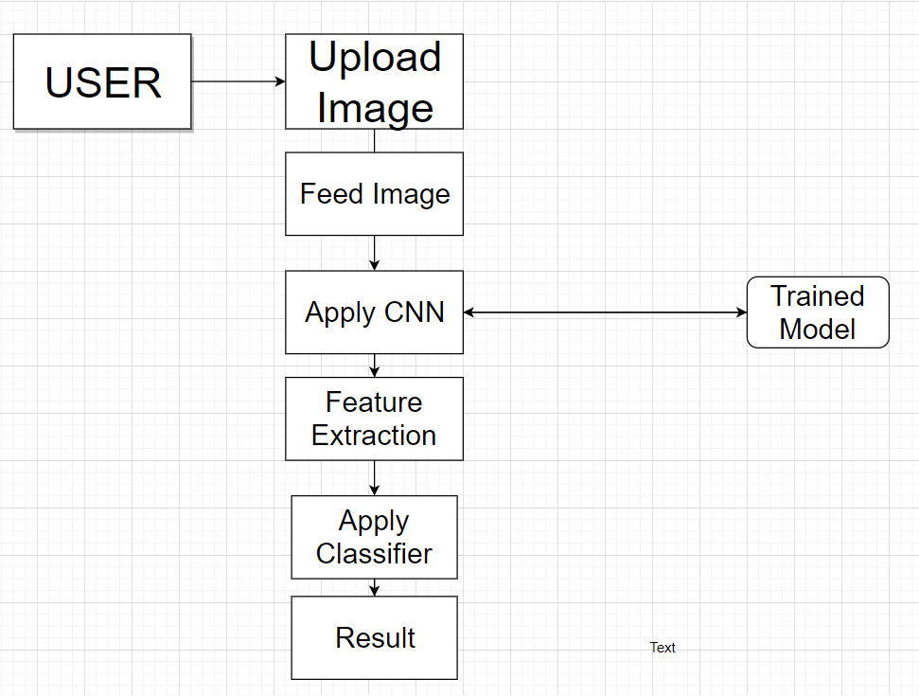
Flow Chart

Slide 5
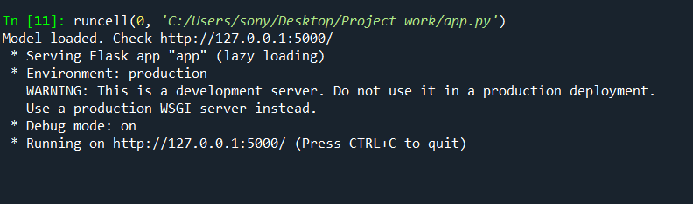
FLASK
Flask is a popular, extensible web microframework for building web applications with Python.
It is a lightweight WSGI web application framework.

Slide 6

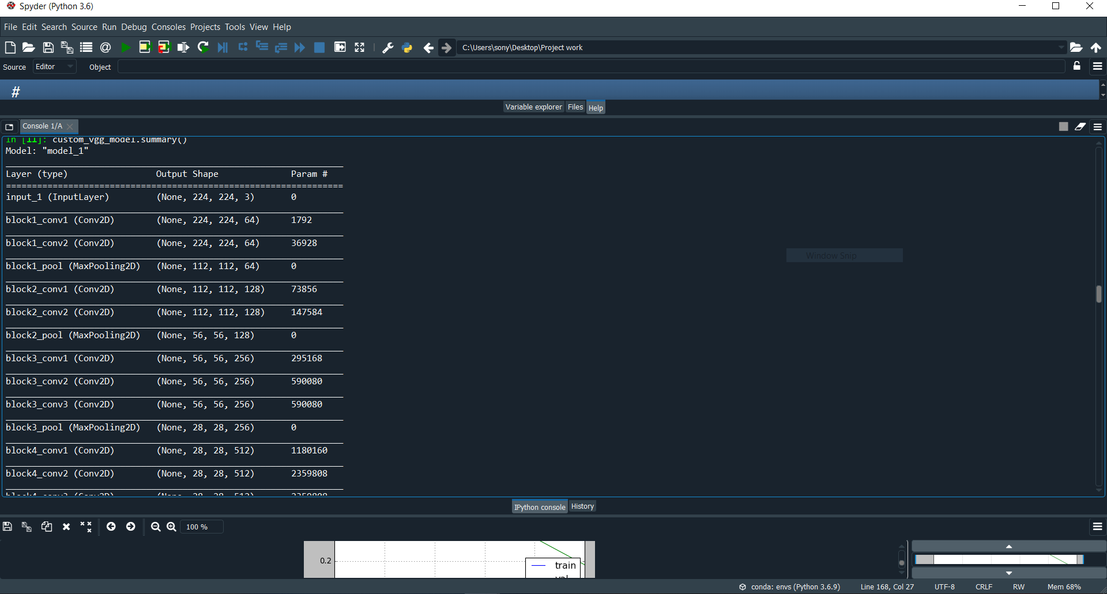
Model Summary

Slide 7
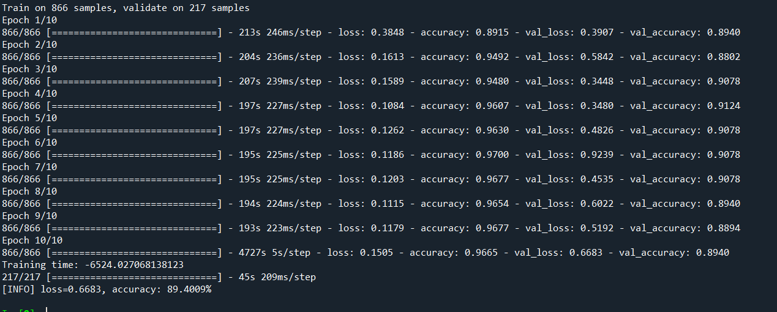
Results
Accuracy:89.4009%, Loss=0.6683

Slide 8
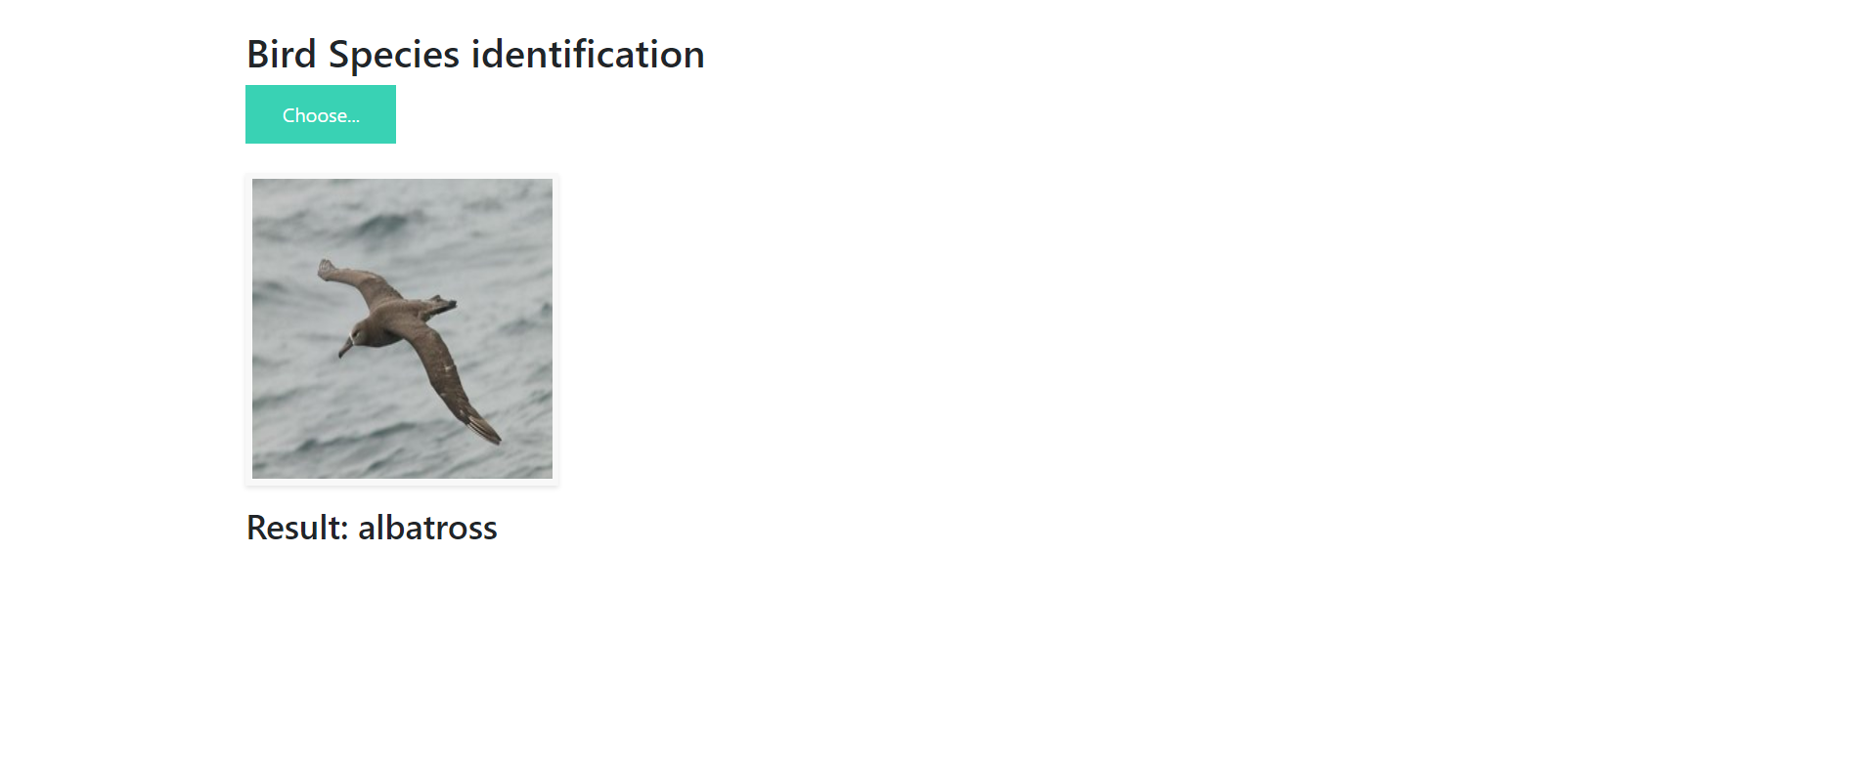
Testing
Model Deployed in Web

Slide 9
THANK YOU ☺ ☺

